Slide 1
https://powercybertestbed.ece.iastate.edu/

Slide 2
Week 11/27

Slide 3
Work - Tyler
Nothing much to report. Still looking into creating big malformed packets to perform a DoS. I am also going down the rabbit hole of trying various other things, but there is nothing fruitful yet.
This upcoming week I will be working with the rest of the team to get everything ready for our board presentation next week. I won’t be able to do much more than that as I have to also finish projects for other classes.

Slide 4
Work - Zach
Prep material for our board presentation next week.
Continue to update the attack website

Slide 5
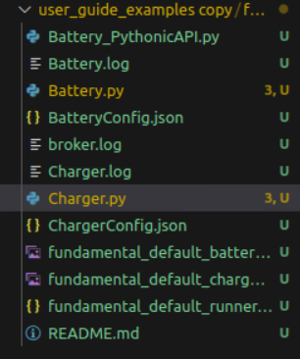
Work - Kaya
Tried experimenting with deleting the other runner files in the example as discussed with Dr. Ravikumar on the Friday before break.
The example ran with just the fundamental_default_runner.json file, as shown in the picture, which means the other runner files/any other files are not necessary for successfully running a helics simulation. What we need to have it run must be within the charger.py and battery.py implementations.
This upcoming week I’ll work on looking more through the docs to figure out how to get the simulation to run together, since there is some other problem here.

Slide 6
Work - Justin
I met with Dr. Ravikumar and one of the Grad Students, Rolf Anderson the Friday before break. This was a very productive meeting in which we discussed how to properly have the Docker environment set up.
I learned a lot about Dockerfiles - Having each Docker run a Flask application was mentioned, which would allow the apps to communicate with each other easily - as well as perpetuate
I was not able to keep the Docker instances perpetuating after completing, but this can be worked around.
I will continue to dig into this and hopefully get something completed before the end of the semester. I will continue to meet with Rolf as needed to check in on the Docker environment.

Slide 7
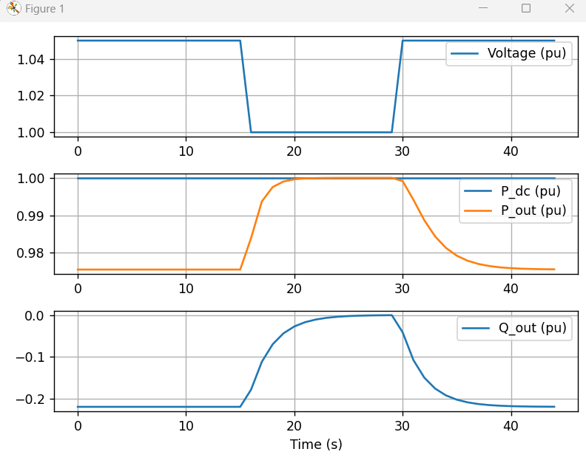
Work - Tommy
OpenDER:
Created a steady state example to explore the volt-var function
Code creates a distributed energy resources (DER) based on the IEEE 1547-2018 Cat B default setting, meaning the nameplate rating is 100kW, 100kVA
I set 1.0 PU to this object then updated the input of the object to a incoming voltage of 1.05 PU
Ran a dynamic simulation for 45 seconds and plotted
Can see that when the incoming voltage is 1.05 the DER absorbs about 0.22pu of the reactive power (Q)

Slide 8
Work - Tommy
Created an example to test the Battery Energy Storage System(BESS)
Created an BESS object and enabled volt-watt control with IEEE 1547-2018 default settings
Tested three different scenarios, voltage PU at 1, 1.09, and when the battery is charging (accomplished by setting der_obj.der_file.PV_CURVE_P2 = -1)
These three examples simulated when the volt-watt control was inactive, active, and in charging mode which limits the DER output power.
After each separate input, I ran a simulation and displayed the results

Slide 9
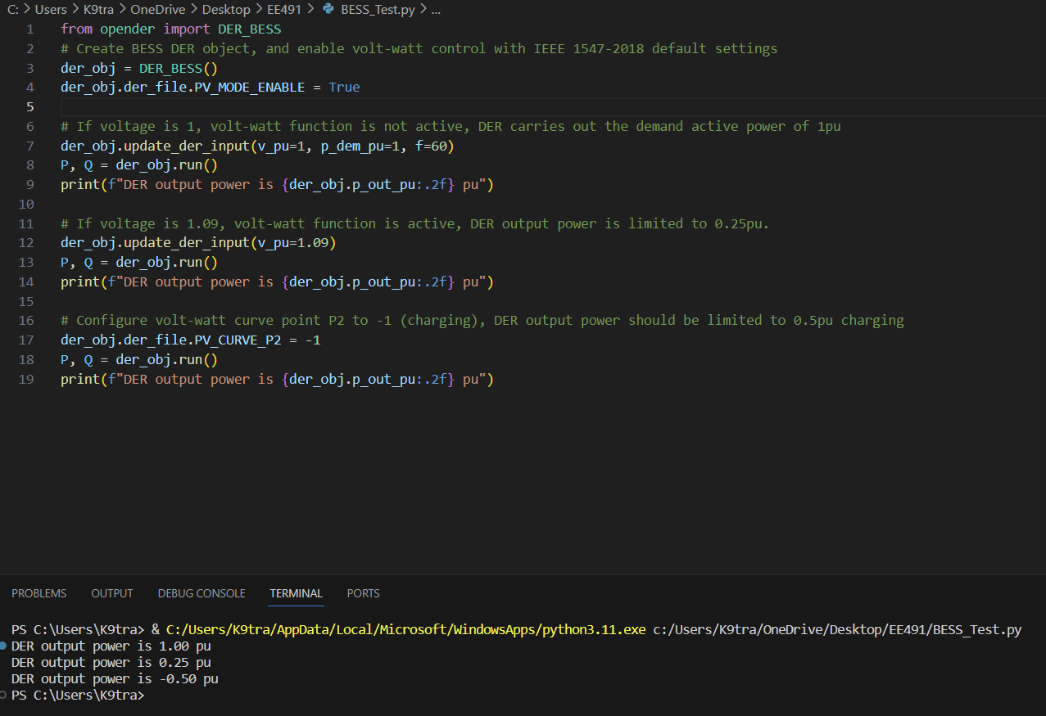
Work - Tommy
BESS Simulation code/result

Slide 10
Work - Matt
Ran base example in pandapower

Slide 11
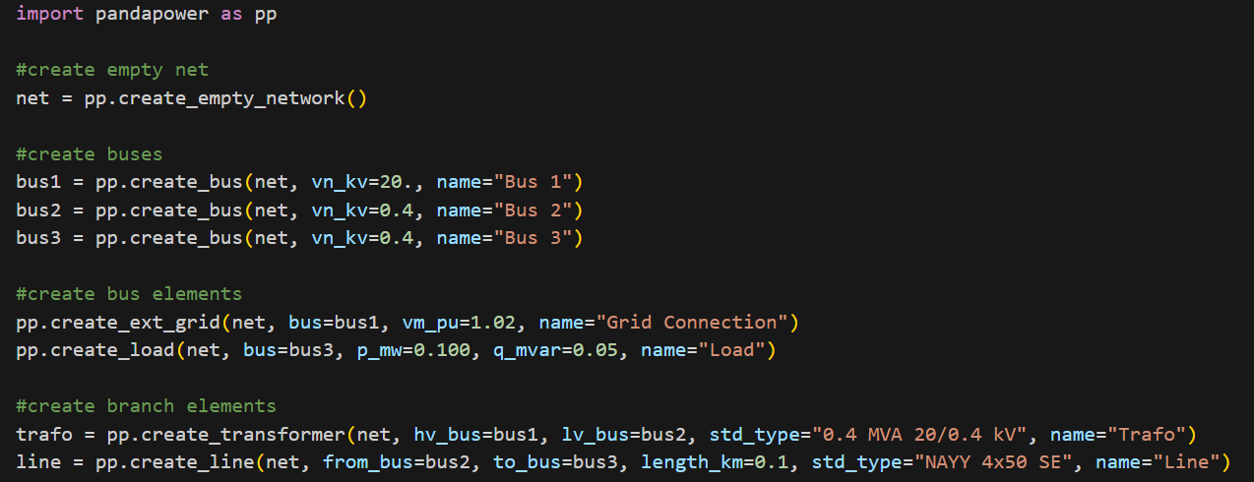
Work - Matt
Explored the pandapower github and ran through some examples

Slide 12
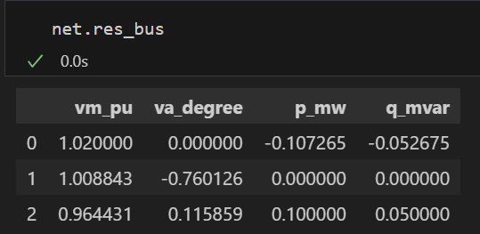
Work - Matt

Slide 13
Next Week's Plan
Justin will work on properly setting up the environment
Help Kaya with HELICS issues as well
Try to communicate OpenDER & OpenDSS
Sudo chmod 666 /var/run/docker.sock

